Slide 1

GeneX
Genetics made practical

Slide 2
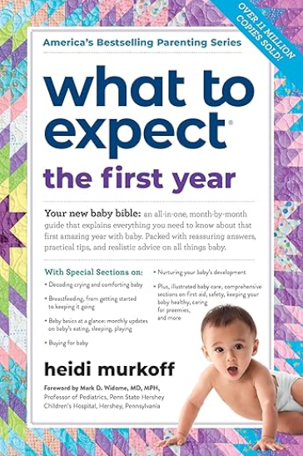



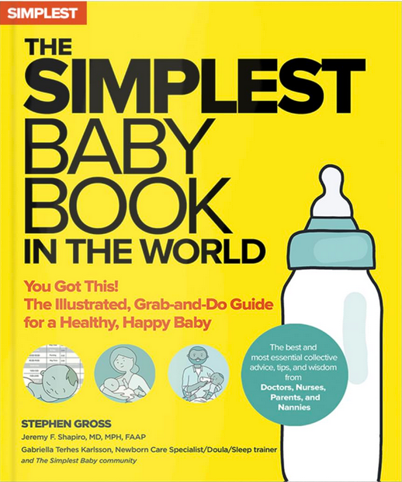


Typical guides fall short
There are many parenting books and guidelines on the market.
Notes:
Plot: the books fall over each other (stack of books), and make a stack of books.
Voice over: There are many parenting books and guidelines on the market

Slide 3


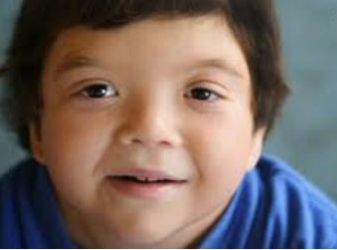

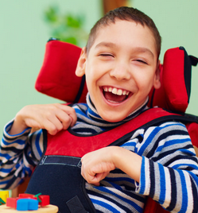

Typical guides fall short
But typical parenting milestones and guides don’t fit every child.
Specially for families of children with unique genetic, neurological, sensory, or multifactorial conditions
These guides often stop just where the real journey begins.
Notes:
Plot: The photos of the kids appear one by one and stack of books appears at once after that a cross would come over the books (meaning those books are useless now)
Voice Over: But typical parenting milestones and guides don’t fit every child.
Specially for families of children with unique genetic, neurological, sensory, or multifactorial conditions.
These guides often stop just where the real journey begins.

Slide 4
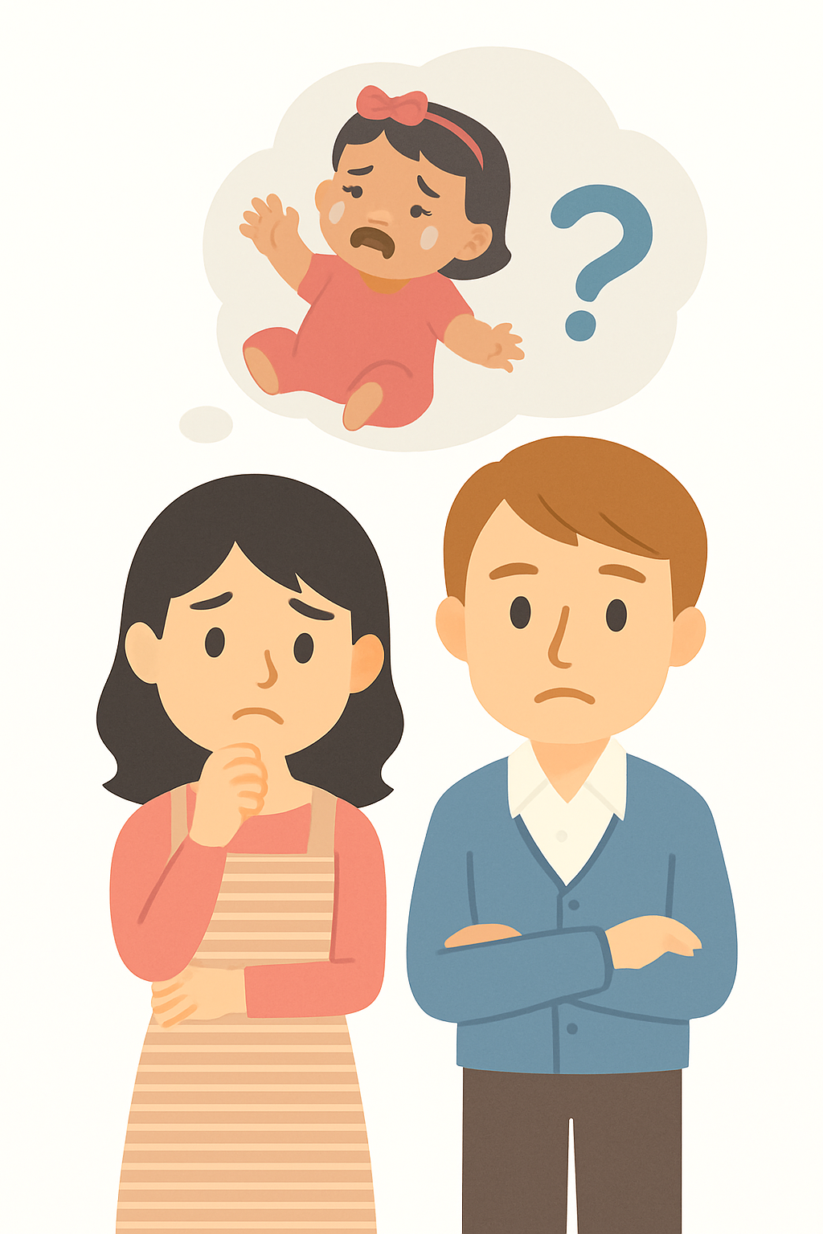





Meet Emma
When Emma was born, everything seemed fine.
But as months passed, her parents noticed she wasn’t sitting, crawling, or talking like other babies at the park.
They felt worried, lost, and unsure why milestones that fit every book didn’t fit their little girl.
Birth
2m
4m
6m
8m
10m
Notes:
Plot: milestone bar appears, and those milestones get added one by one
Voice Over: Emma was born with Down syndrome—a genetic condition that affects learning, speech, and muscle tone.
While other babies at the park were sitting, crawling, and talking, Emma was on her own timeline.
Her parents felt worried, lost, and overwhelmed by milestones that didn’t seem to fit their child.

Slide 5
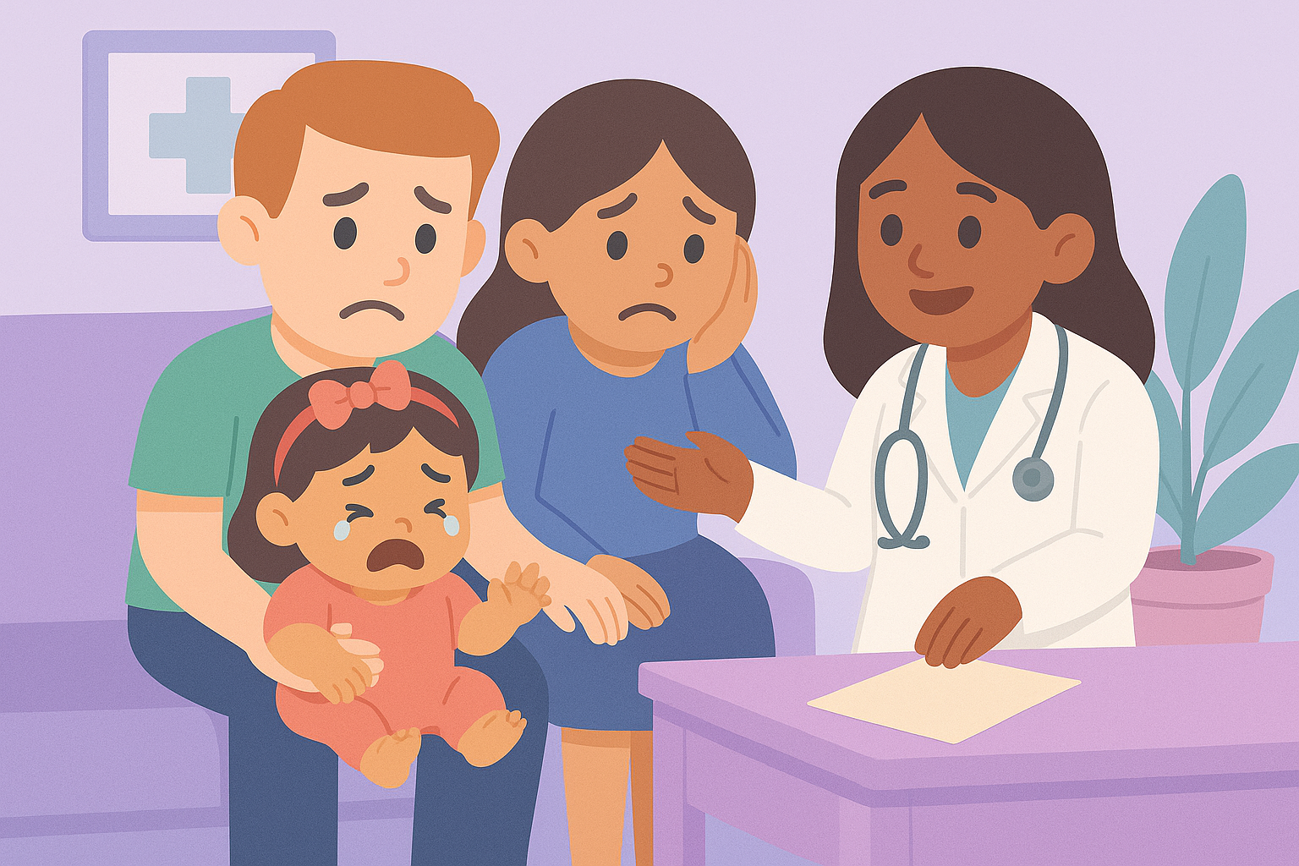
Diagnosis… then what?
After months of worry, Emma’s parents finally got an answer — she was diagnosed with Down syndrome, a genetic condition that affects learning and development.
The diagnosis brought clarity… but also uncertainty.
Once they left the doctor’s office, apart from bunch of handouts, there was no roadmap, no plan for Tuesday’s therapy, or next month’s progress.
Notes:
Voice Over: After months of worry, Emma’s parents finally got an answer — she was diagnosed with Down syndrome, a genetic condition that affects learning and development.
The diagnosis brought clarity… but also uncertainty.
Once they left the doctor’s office, apart from bunch of handouts, there was no roadmap, no plan for Tuesday’s therapy, or next month’s progress.

Slide 6
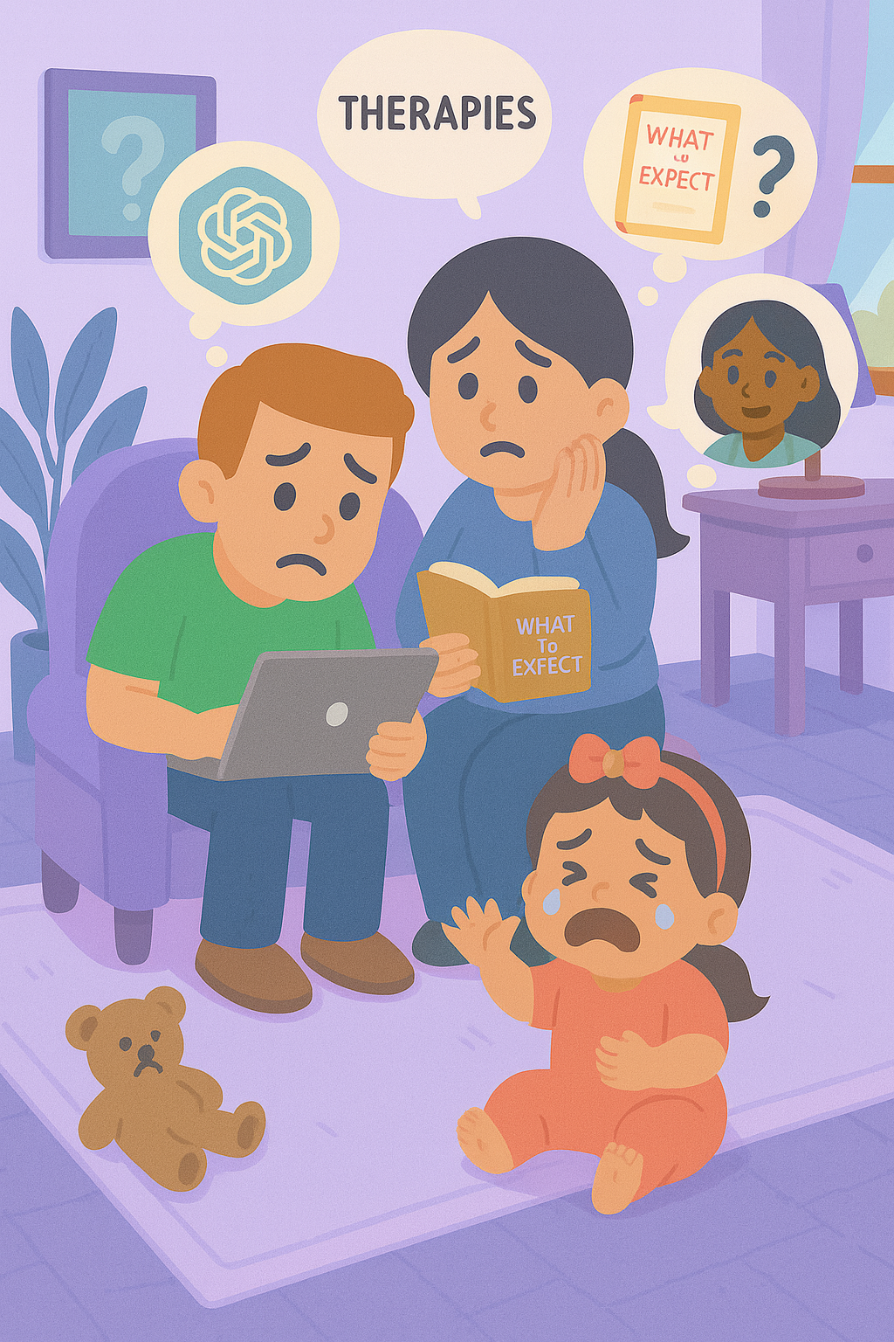
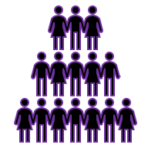
A Name, But NO Plan
MiLLIONS OF FAMILIES
Routines are hard to follow
and support often feels out of reach.
Guidance is fragmented
Notes:
Plot: The photo of family appears, then while the voice going over these three points, the icon and text for each one appears one by one.
Voice over: Millions of families, just like Emma’s, are navigating genetic and neurological conditions, searching for clarity, connection and hope.
But the guidance they find is often fragmented, routines are hard to follow, and real support feels just out of reach.

Slide 7
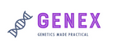
That’s why we built Genex

Slide 8



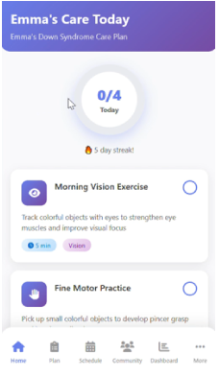


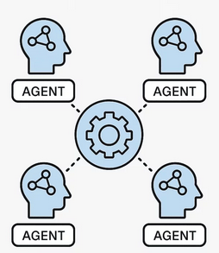


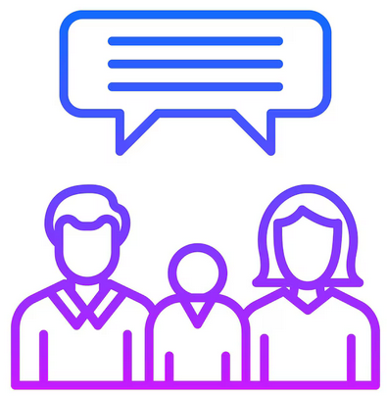


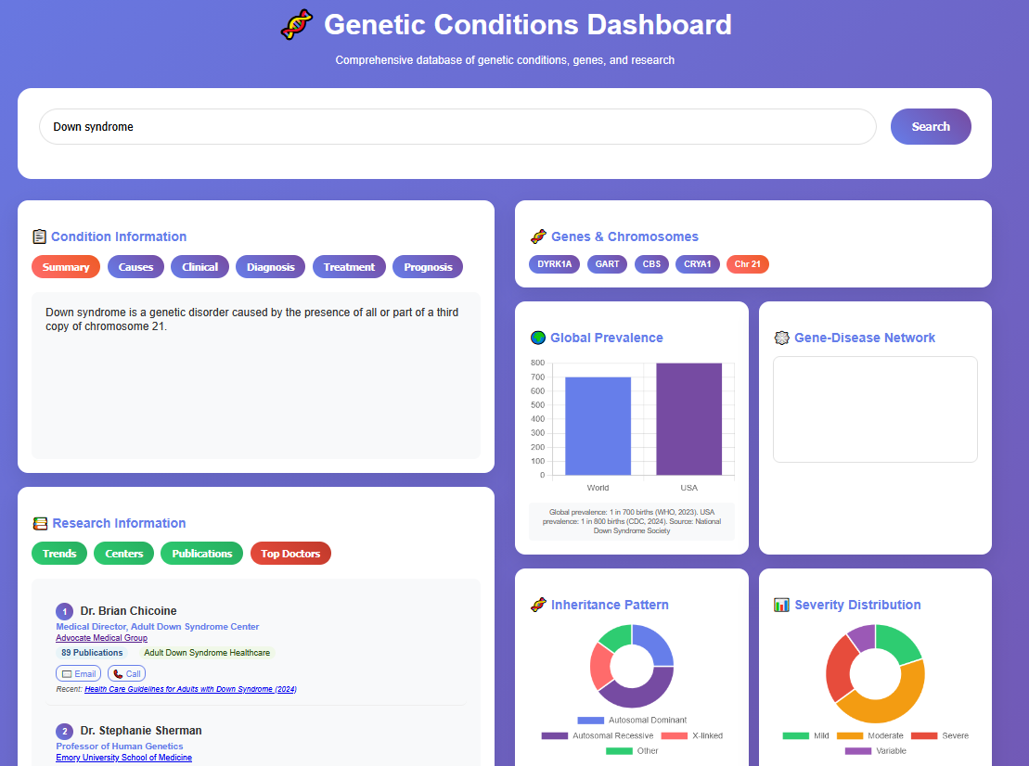

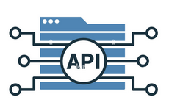


Genex – Technology
An AI care framework that learns with every family
Genex Core AI
Knowledge Graphs
Notes:
Plot: icons progress from left to write, all the data sources feed to the core AI model and core AI model creates the app and dashboard. And there would be a loop to feedback from app and dashboard to the core AI.
Voice over:
An AI framework that learns with every family.
- Genex unifies data from research, clinical guidelines, and family feedback.
- At its heart lies a biomedical knowledge graph, where micro-agents and language models work together to interpret complex genomic and clinical data.
- This intelligence powers the Genex App and Dashboard — offering daily care plans, progress tracking, and shared insights for families and clinicians.
- Privacy is built into every layer. Each new study, clinician note, and family interaction feeds back into the graph — making Genex smarter and more precise over time.

Slide 9
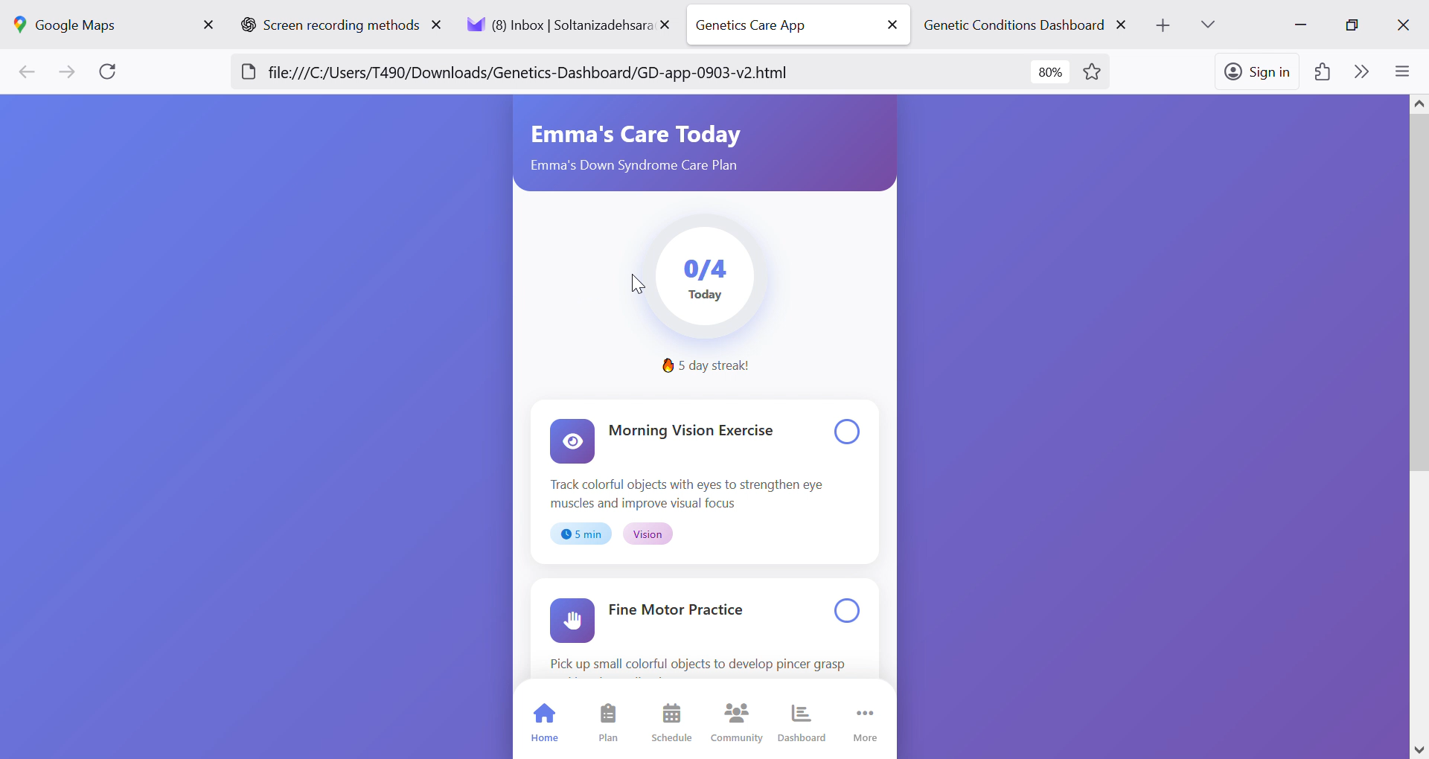
Introducing Genex – App
Care plans
Curated daily 5–10 minutes activities
Gentle reminders
Progress tracking
A supportive community
Free
Notes:
Plot: The video plays and voice go over the voice over at the same time. The family doing daily activities drop one by one at the same time
Voice over: For families like Emma’s, the Genex App turns uncertainty into daily clarity.
It offers personalized care plans, short 5–10-minute activities, gentle reminders, progress tracking, and — most importantly — a supportive community.
Through Genex, Emma’s parents found small, consistent steps that built big confidence — learning how to support her speech, motor skills, and play routines every day. And the best part? Genex is free, so every family can access practical, personalized guidance right from their phone.

Slide 10
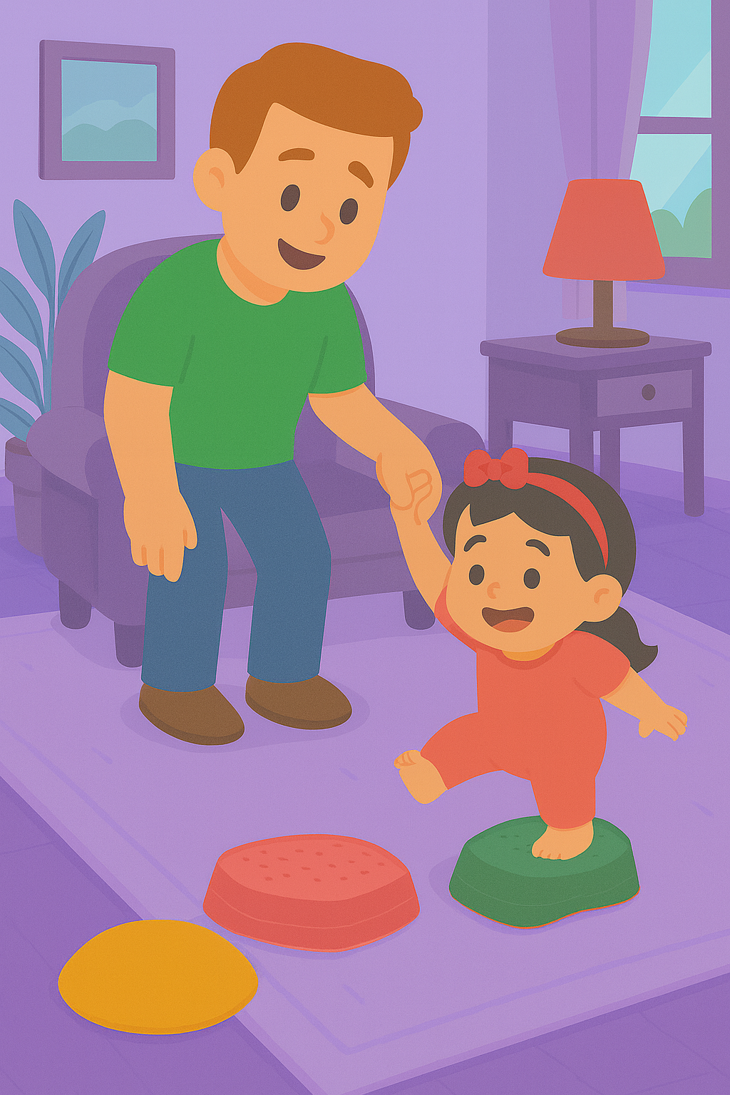
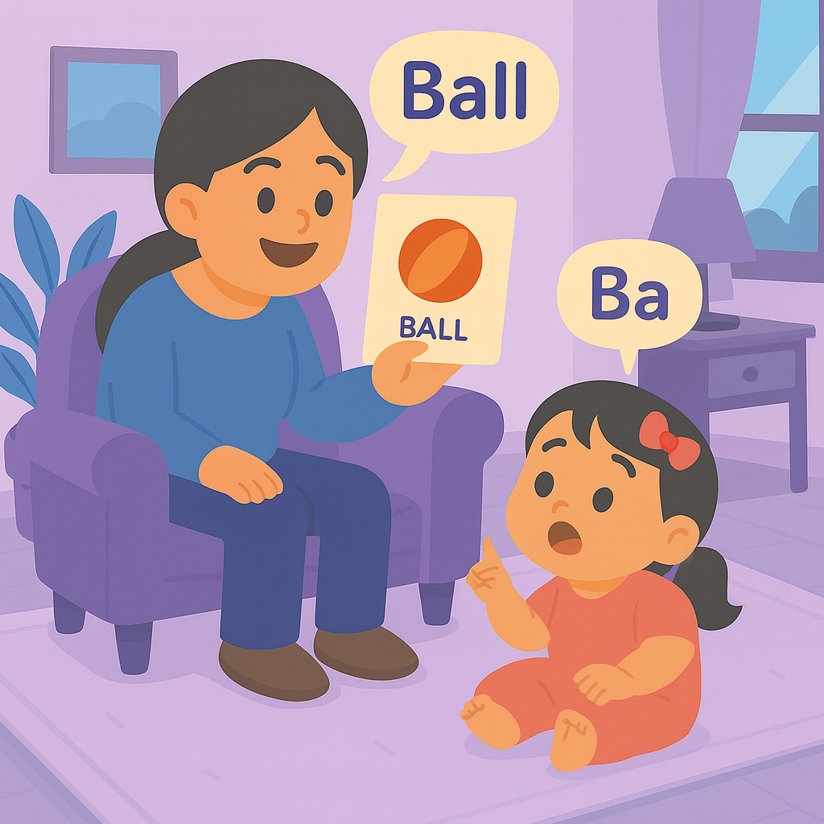
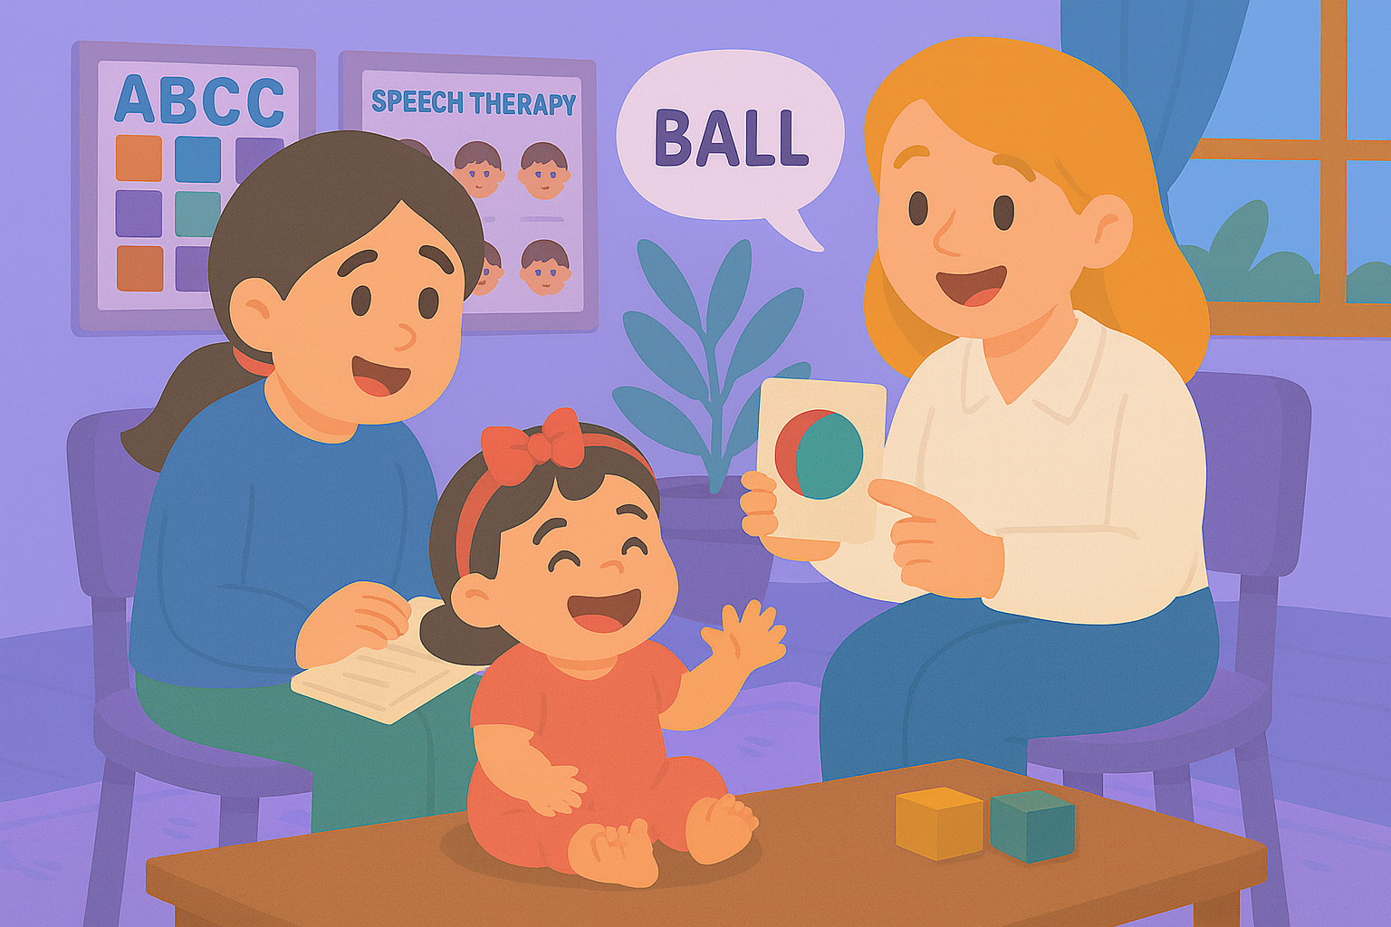
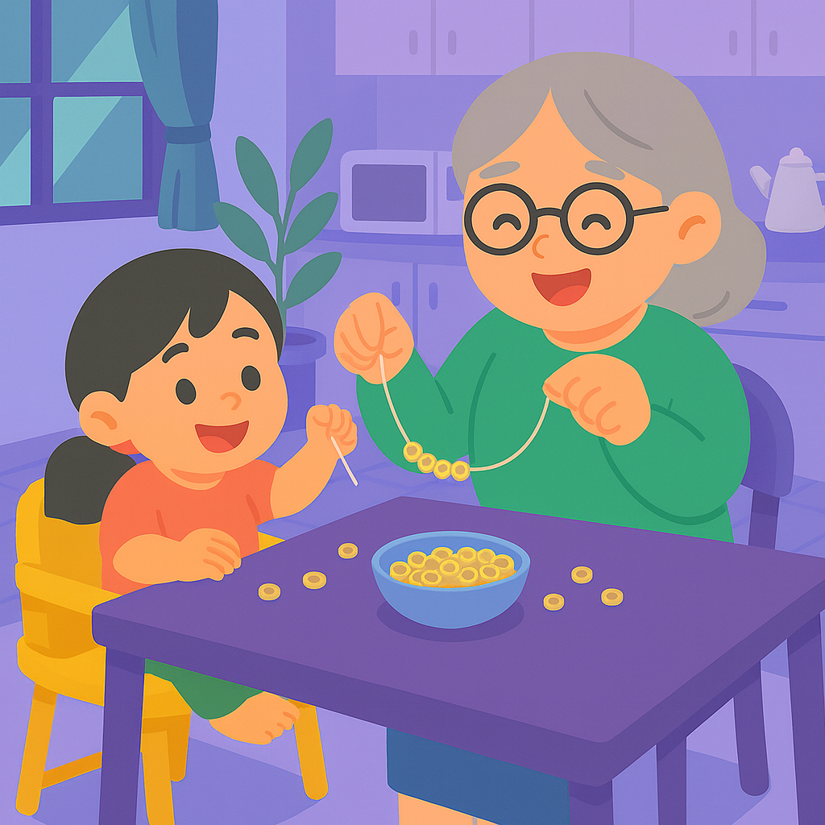
Genex – App
Helps:
Families gain confidence
Schools and medical teams stay aligned
Children get consistent help - every single day.
Support is multilingual and inclusive
No one walks alone.
Notes:
Plot: The video plays and voice go over the voice over at the same time. The family doing daily activities drop one by one at the same time
Voice over: Through the Genex App, families gain confidence, teachers and therapists stay aligned, and children get consistent support — every single day. Daily activities are clear, short, and encouraging — helping everyone, even Grandma in her own language, support Emma’s speech, movement, and routines with joy.

Slide 11
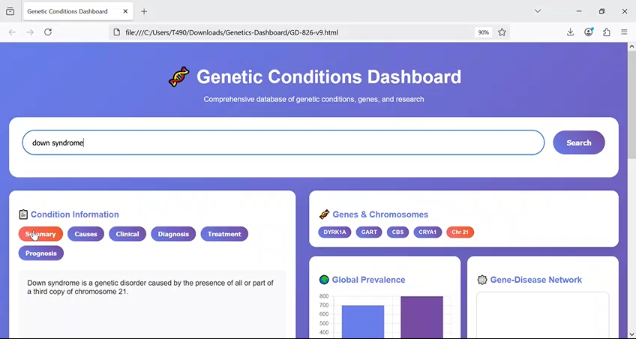
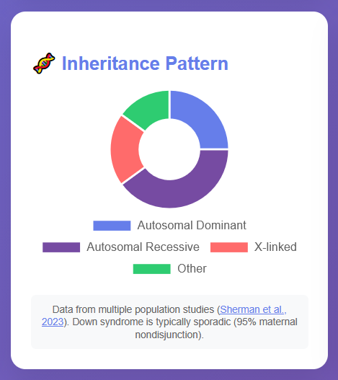
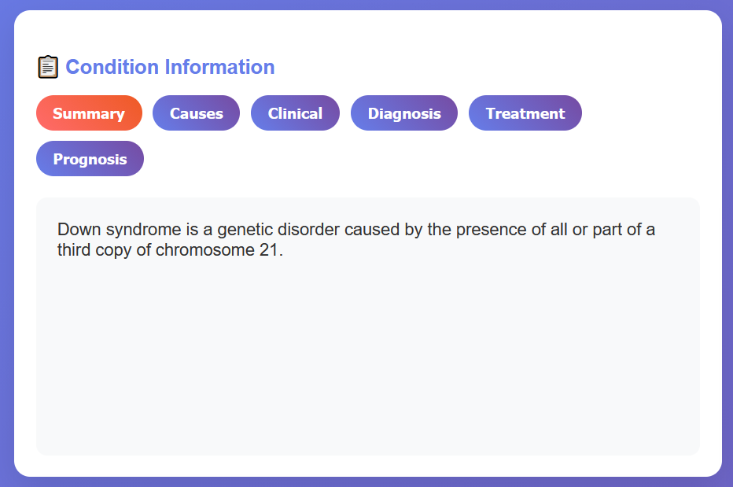
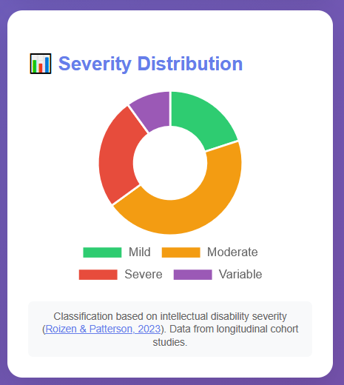
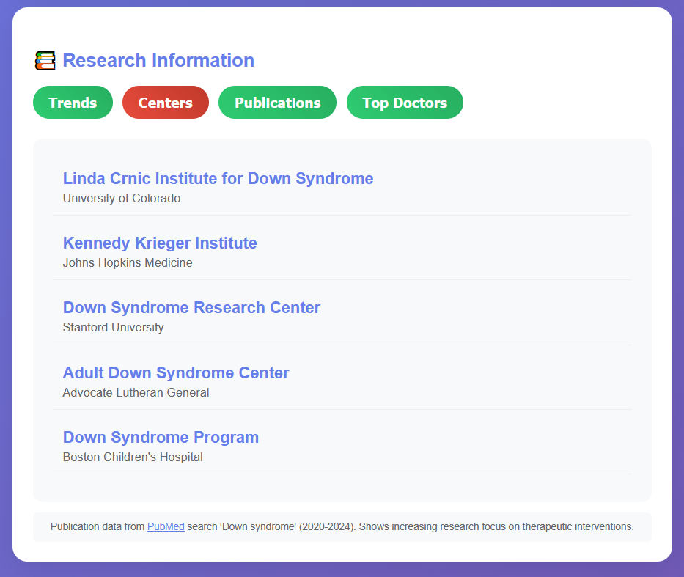
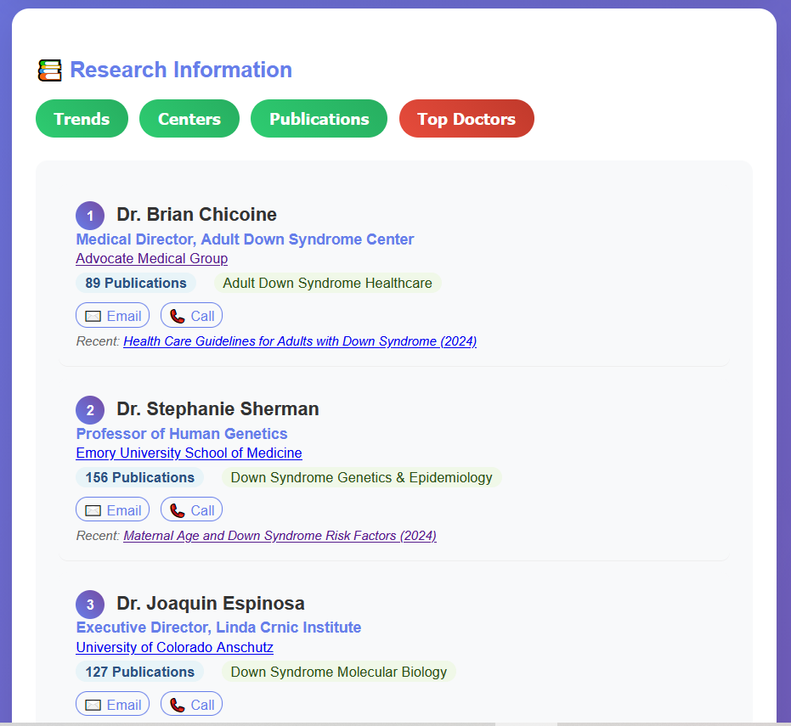
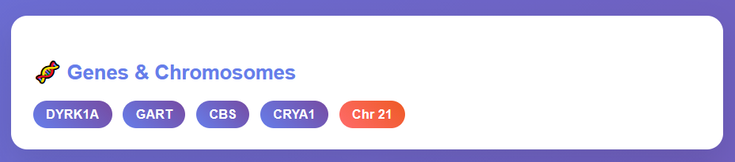
Introducing Genex – Dashboard
Offers:
Search and condition cards with source and confidence
At a glance visuals
Research lens including centers and top clinicians
Notes:
Plot: The video plays and voice go over the voice over at the same time. Need to zoom in every part of the dashboard when we are talking about it in the voice over
Voice over: With Genex, families gain access to a free, intelligent dashboard that brings all the medical and scientific information about their child’s condition into one trusted place. Instead of searching endlessly on Google, ChatGPT, or asking friends and relatives, Emma’s parents can now find everything about Down syndrome — from therapies to research — in one clear, reliable hub.
The dashboard offers search and condition cards with verified sources and confidence levels, at-a-glance visuals for easy understanding, and a research lens highlighting leading centers and top clinicians.

Slide 12
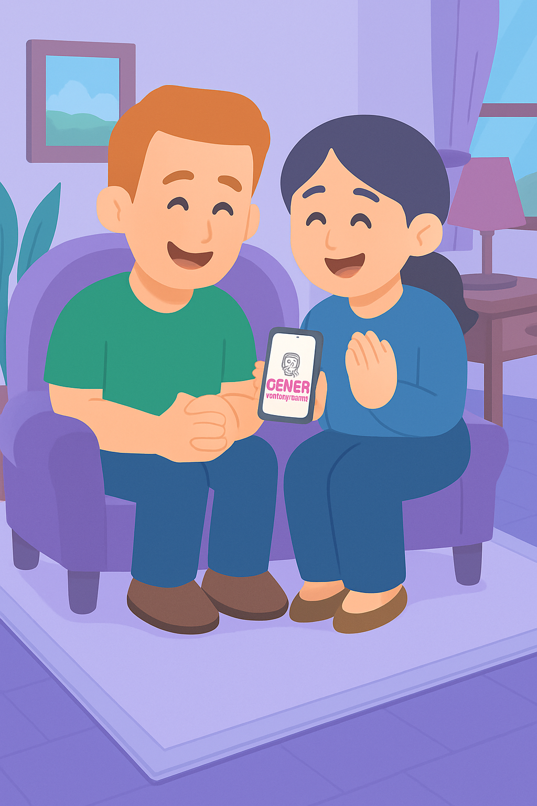
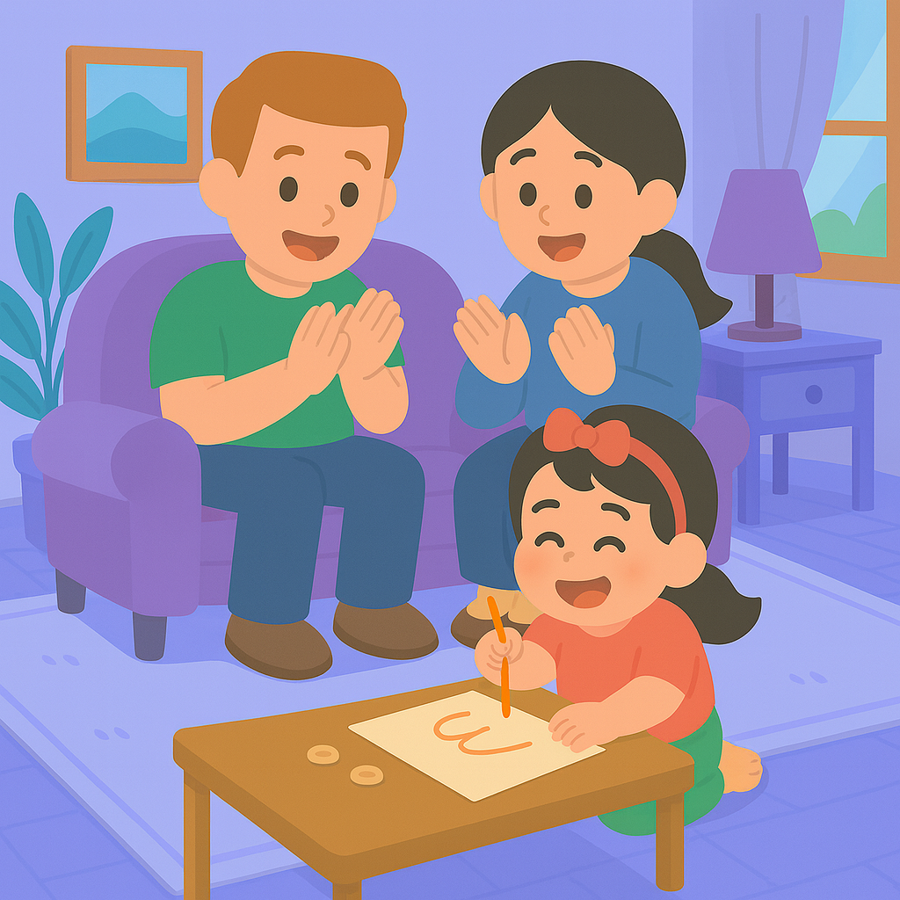
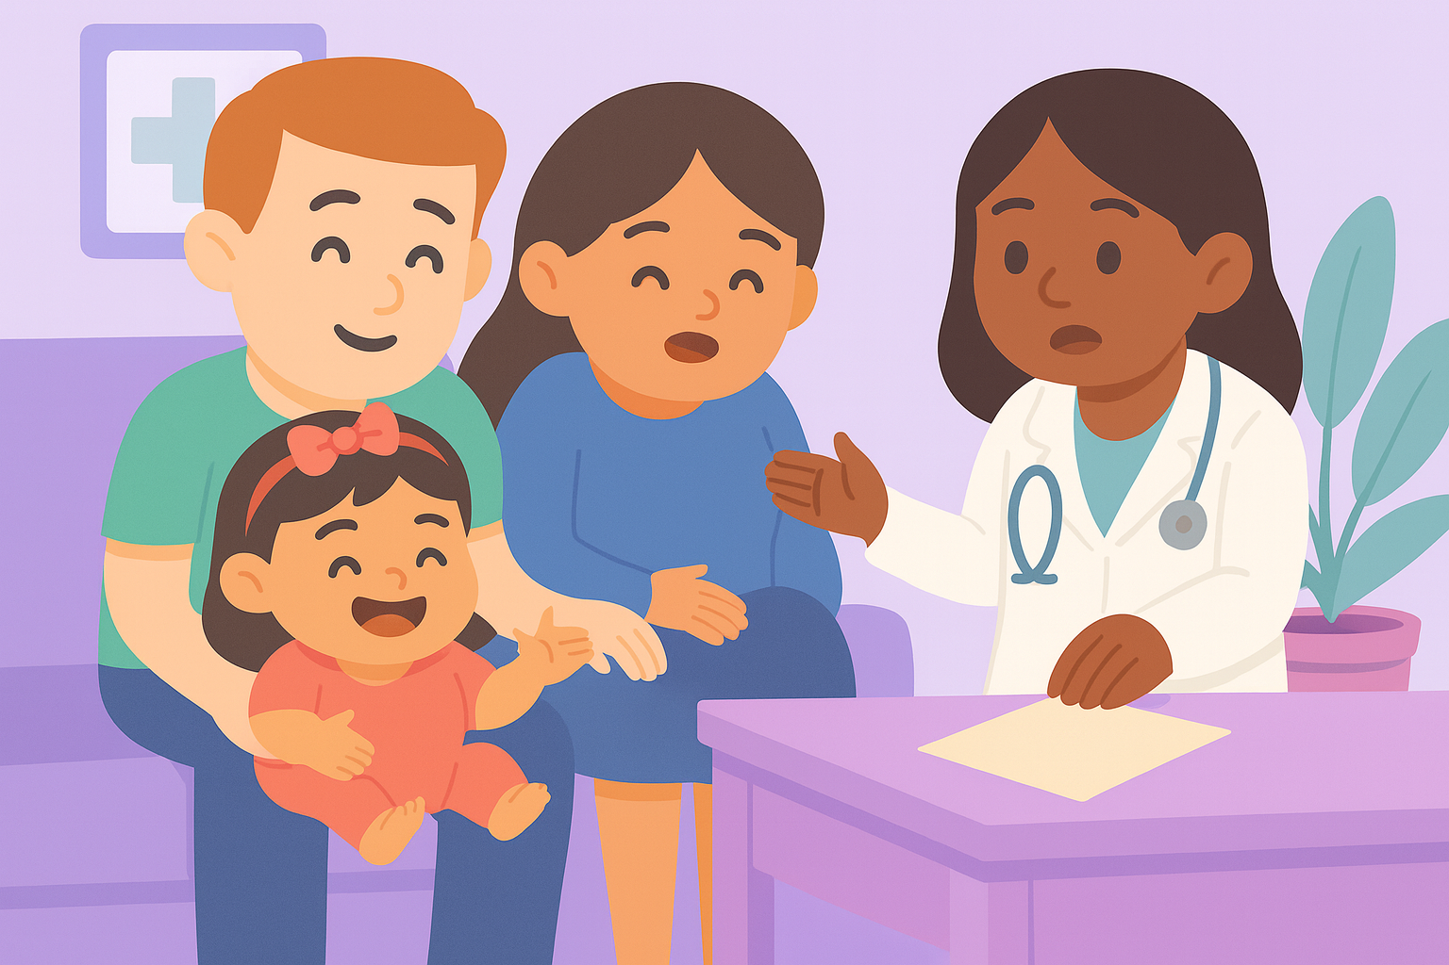
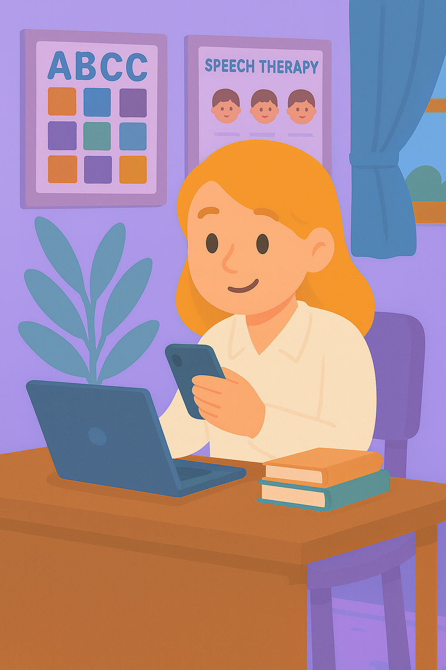
Genex – Dashboard
Helps:
Families understand their child’s situation better
Know what to ask their doctors
And providers to stay synched and give feeback.
Notes:
Voice over: Using the Genex Dashboard, families understand their child’s situation more clearly and know what to ask during medical appointments.
They can even discover where to go for expert opinions or the latest clinical trials.
Clinicians can provide feedback, refine recommendations, and stay connected — making care collaborative and continuous.
And for families facing rare genetic or neurological conditions, where reliable information is scattered, Genex brings everything together — simply, securely, and in one place.

Slide 13
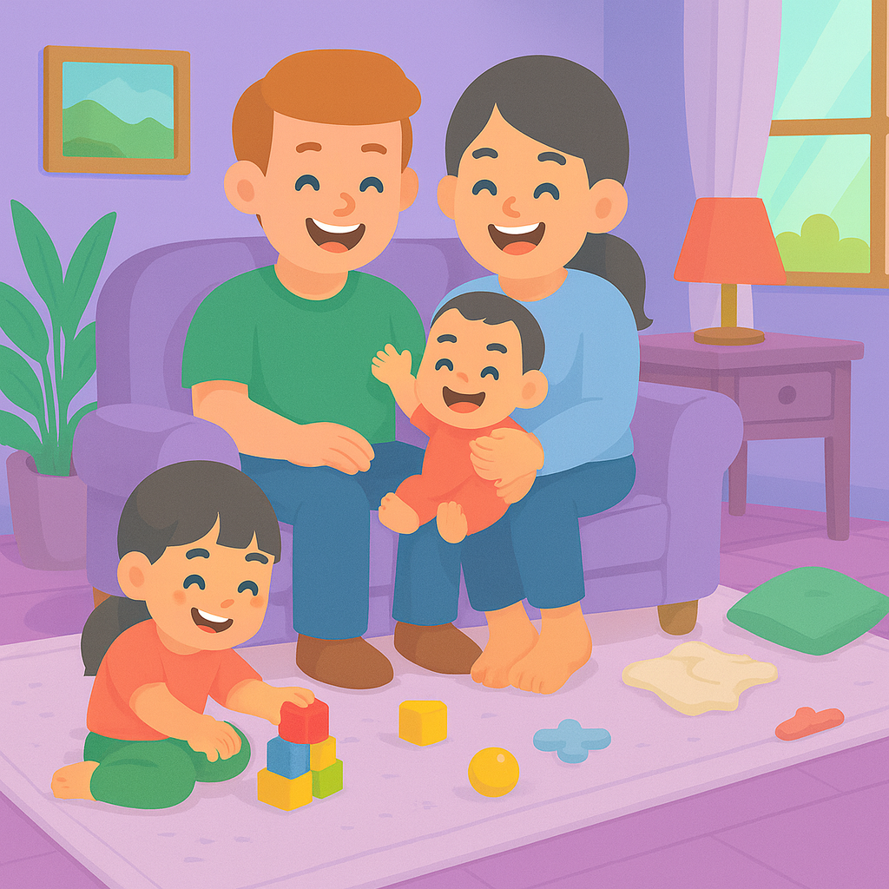
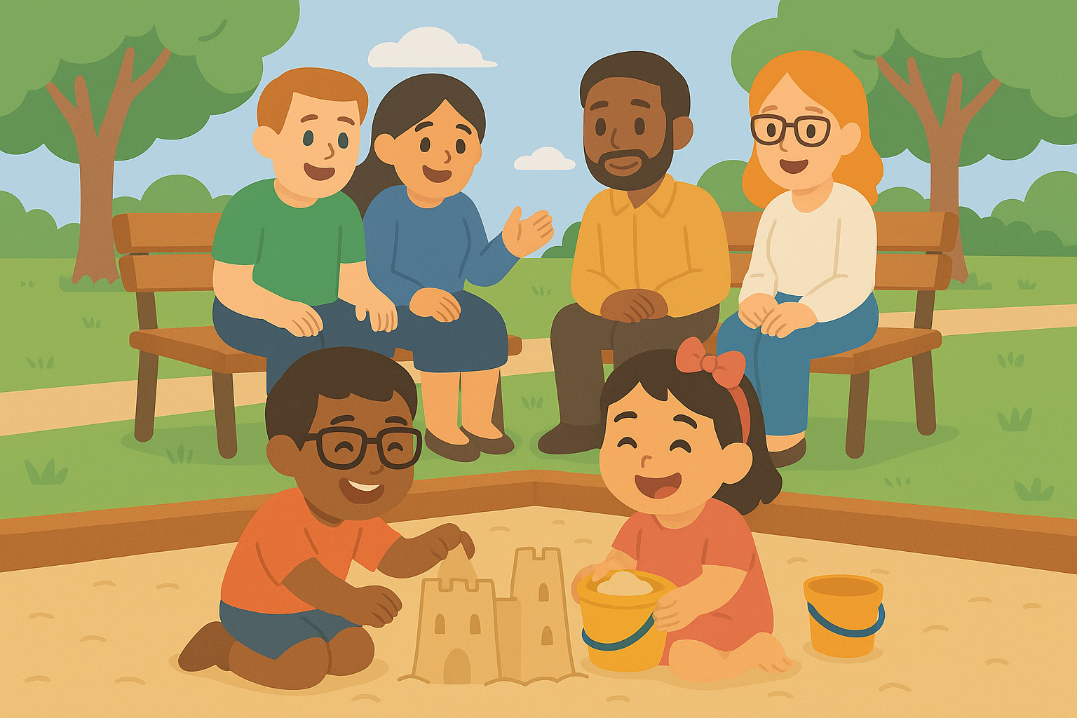
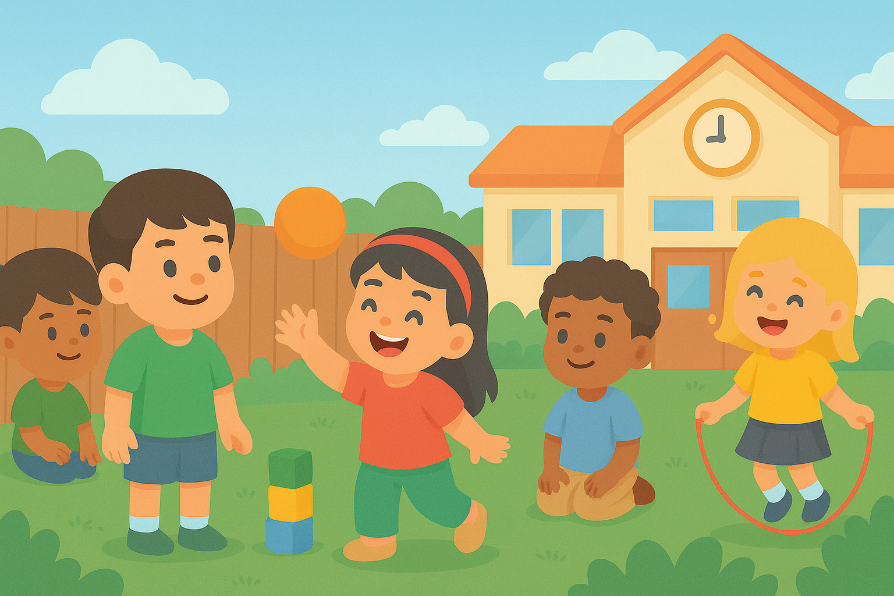
Together
Genex turns uncertainty into confidence, and diagnosis into daily progress.
Together we make care:
Simpler
Smarter
Supportive
Notes:
Plot: The video plays and voice go over the voice over at the same time.
Voice over: For Emma and millions of children like her, Genex turns uncertainty into confidence, and diagnosis into daily progress. With Genex — families don’t just manage care, they live it with clarity, joy, and support.

Slide 14
GeneX
Genetics Made Practical
Notes:
Plot: The text come one word at a time, and then Genex logo appears.
Voice over: Genex, Genetics made practical.

Slide 15

Join Emma’s family and a global community of parents learning, sharing, and growing together.
Scan the QR code to try our free app.
Notes:
Plot: First the logo and QR code appear then, The text come one word at a time and voice read them.
Voice over: Join Emma’s family and a global community of parents learning, sharing, and growing together. Scan the QR code to try our free app.

Slide 16
Notes:
Adding soft music transitions between Emma’s story (emotional) and the Genex tech part (uplifting).
Including subtle pauses after lines like “That’s why we built Genex.”
Using motion visuals (zoom on dashboard, app interactions, etc.) to break up the narration and create natural breathing space.

